Slide 1






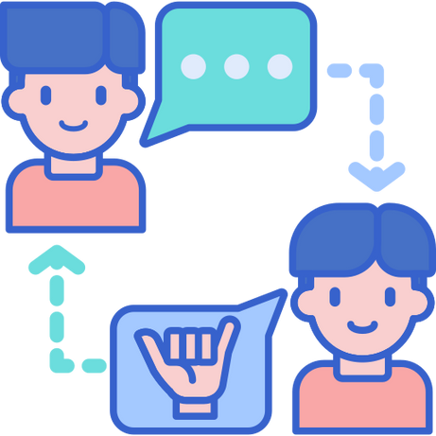









Sign-Language Translator
Presented by MP23CST024
Guide-Name: Mr. Vivek Tomar
Team: Ambuj Tripathi(2017459)
Suryansh Makhloga(2017563)
Sandeep Singh(2017547)
Saatwik Semwal(2017538)

Slide 2

Introduction
Globally, sign and gesture recognition plays a significant role, yet the lack of familiarity prompts the need for innovative technologies. Bidirectional sign language translation systems are essential, especially for scenarios like a deaf person seeking assistance in a grocery store. With over 466 million deaf individuals worldwide using diverse sign languages, there's a pressing need for technological solutions.
Despite technological advancements, sign languages, including ASL, have often been marginalized. The complexities of sign language require expertise in various fields. Bidirectional sign language translation involves Sign Language Recognition (SLR) and Sign Language Production (SLP).

Slide 3

Literature Review
Edge Detection & Grayscale: Abdulhussein et al. [1] explored hand movement prediction for SLR but faced limitations in landmark identification.
Sensor-Based Methods: Chong et al. [5] and Rinalduzzi et al. [20] used leap motion controllers and sensor gloves, respectively, but both were costly and impractical.
Color & Contour Extraction: Haria et al. [8] focused on finger counting, struggling with complex gestures.
High-Accuracy CNN Models: Pigou et al. [17] succeeded with Italian gestures, using techniques like contour extraction and data augmentation [7, 10].
Deep Learning in Gesture Recognition: Tomar et al. [22] highlighted robust feature extraction for accurate, real-time recognition.
Mediapipe Library: Facilitates hand landmark detection, enhancing flexibility and accuracy in diverse conditions [14].

Slide 4
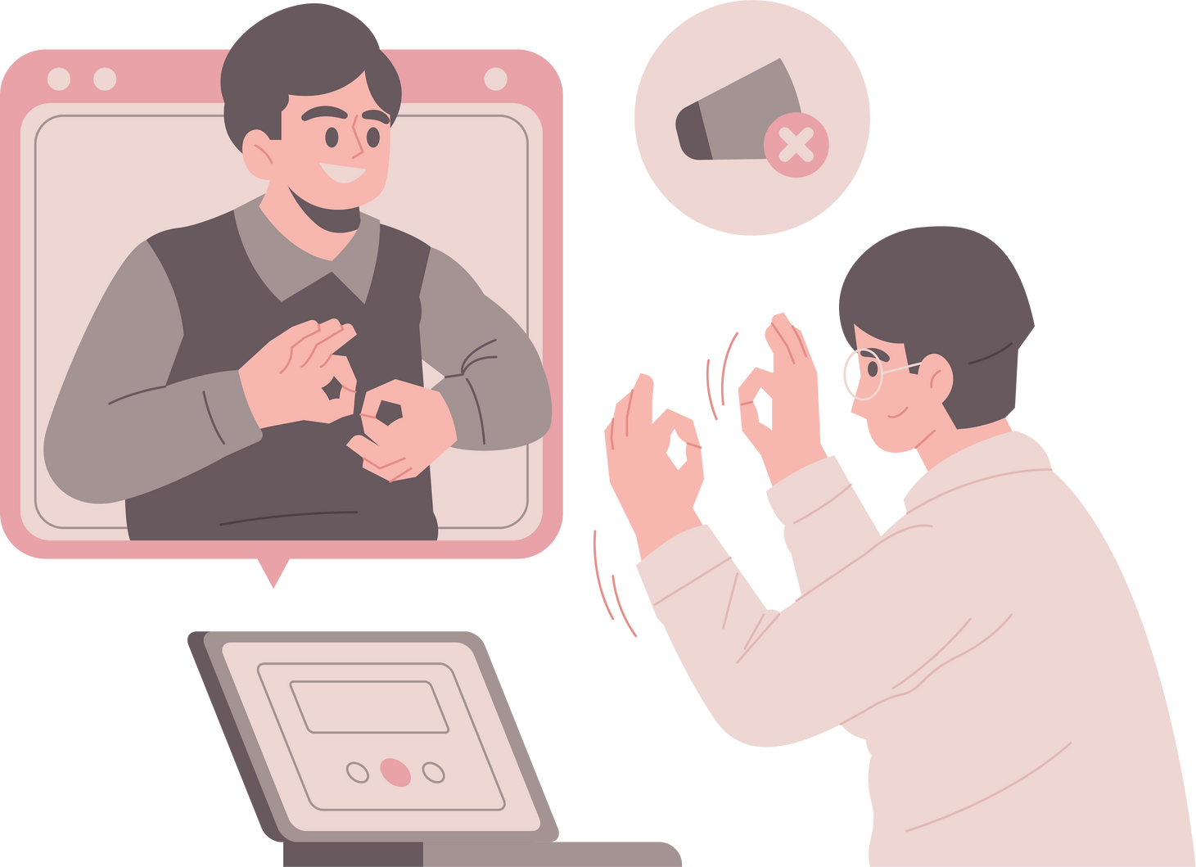
Objective
Our project explores a new approach to Sign Language Recognition (SLR) by leveraging advanced technologies in computer vision and neural networks. Unlike traditional methods that face challenges in diverse lighting conditions and backgrounds, our novel approach addresses these limitations through a combination of innovative techniques.
We get landmark points of hands using Mediapipe library. And draw skeleton of hand to determine accurate result.

Slide 5
Methodology
Two-layer Convolutional Neural Network (CNN) for static signs and gesture classification.
Multiple-layer CNN model predicting user input frames with Convolution, Pooling, and Densely Connected Layers.
Layer 2: Algorithms ensure accurate detection of similar symbols.
Real-world limitations were tackled, focusing on background and lighting conditions.
LSTM to enhance the accuracy of dynamic gestures under diverse scenarios.
Used Mediapipe for keypoint extraction and creating the data model to get higher accuracy in low data size that increases portability.

Slide 6
Data Collection
01
02
03
04
Webcam-acquired images under different conditions are sent further for processing.
Region of Interest (ROI) extraction, grayscale conversion, Gaussian blur, and binary image conversion.
MediaPipe Landmark System detects and connects hand landmarks in a white background.
Landmark points collected are stored in numpy feature array after normalizing coordinates to create data model.

Slide 7
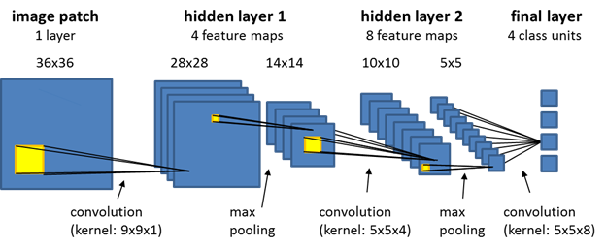
CNN
Convolutional Layers with ReLU activation and MaxPooling:
Purpose: Extract features from input images through convolution and apply non-linearity with Rectified Linear Unit (ReLU). MaxPooling reduces spatial dimensions.
Dropout Layers for Regularization:
Purpose: Introduce dropout layers to prevent overfitting by randomly "dropping out" neurons during training, encouraging the network to learn more robust features.
Flatten Layer:
Purpose: Transition from convolutional layers to dense layers by flattening the output. Prepares for connecting to fully connected layers.
Softmax activation in the output layer.
Adam optimizer is used. The model is trained with 50 epochs and a batch size of 512.

Slide 8
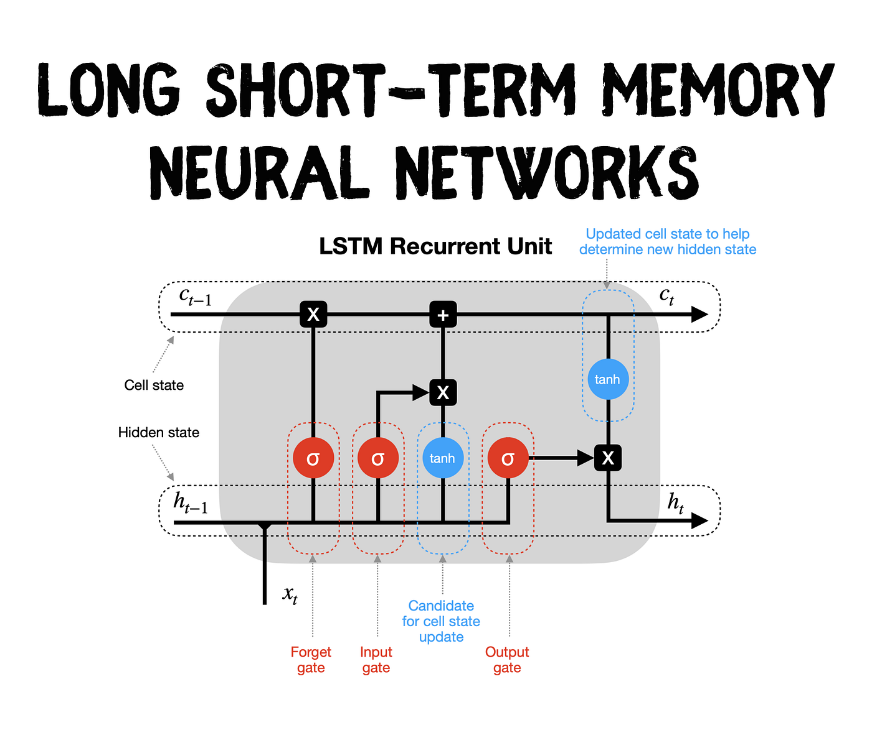
LSTM
Architecture: Sequential model with LSTM layers for temporal pattern recognition.
Training: Utilized Adam optimizer, categorical cross-entropy loss, and TensorBoard monitoring.
Layers: Stacked LSTM layers, dense layers for classification, softmax output.
Prediction & Evaluation: Generated predictions, evaluated with confusion matrices and accuracy score.
Persistence: Saved and loaded model weights for reproducibility and deployment.
Results: Presented confusion matrices and accuracy score for model performance assessment.

Slide 9
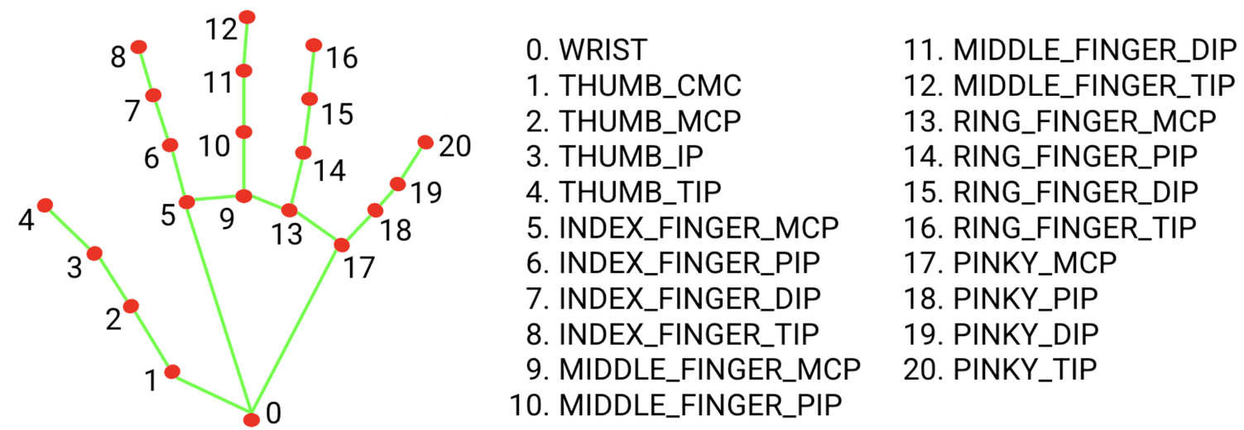
MediaPipe:
Hand landmark model bundle
The hand landmark model bundle detects the keypoint localization of 21 hand-knuckle coordinates within the detected hand regions. The model was trained on approximately 30K real-world images, as well as several rendered synthetic hand models imposed over various backgrounds. See the definition of the 21 landmarks below:

Slide 10
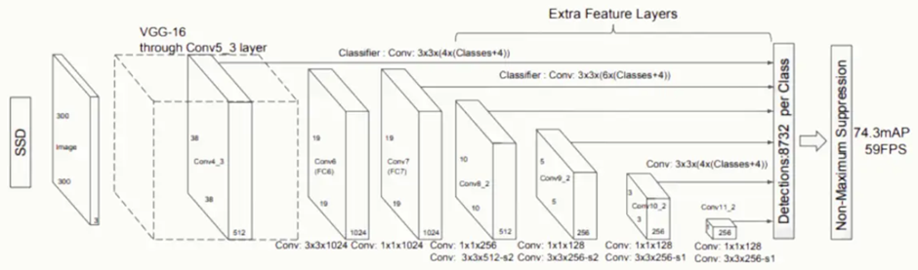
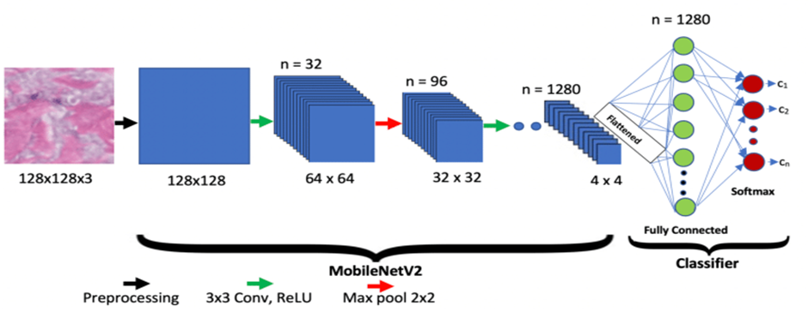

Slide 11
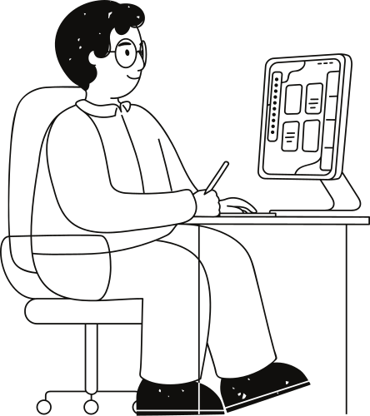
Result:
The CNN architecture successfully captured spatial and temporal features from video streams, enabling accurate sign language recognition for static signs. Whereas, gesture classification includes hands and body movement which was optimized by using LSTM that keeps hand movement in consideration while training.
Preprocessing steps, including hand detection, cropping, RGB conversion, and refined input for the CNN model. The incorporation of the MediaPipe landmark system enhanced adaptability to different signing styles and addressed limitations related to background and lighting conditions. While it uses less data to produce hyper-accurate models enhancing portability. The model seamlessly translated recognized gestures and static signs into words, with the pyttsx3 library facilitating the conversion of recognized words into speech.

Slide 12
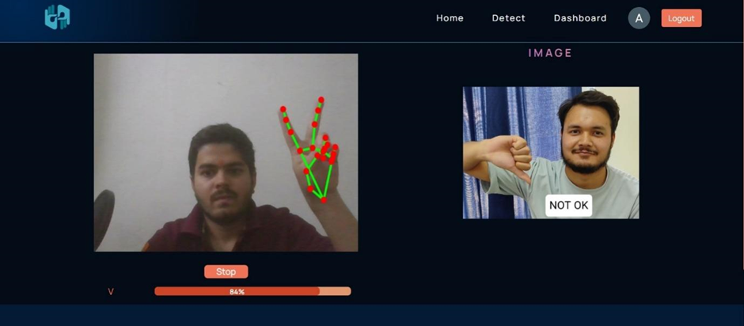
Smooth Interface:
The use of React.js in building the interface for the Sign Language Recognition (SLR) application resulted in a highly responsive and smooth user experience.
The dynamic nature of React.js ensured real-time updates and interactions, crucial for the responsiveness required in a real-time SLR system.
This smooth interaction between the user and the system is vital for maintaining user engagement and providing immediate feedback, prediction on gesture recognition, enhancing the overall usability of the application.

Slide 13
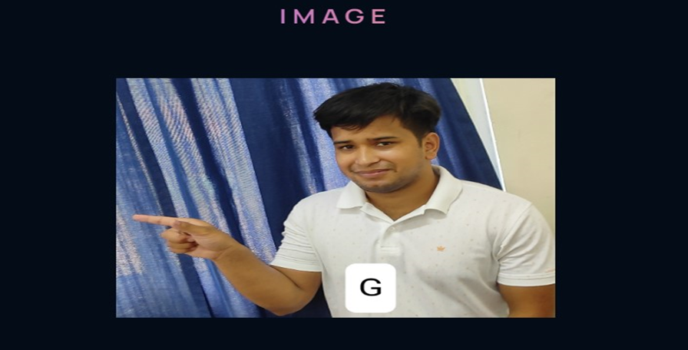
Tutorial
The tutorial section is a critical feature designed to aid new users in understanding and effectively using the SLR system.
Built with React.js, the tutorial provides step-by-step guidance on how to interact with the application, perform gestures, and understand the feedback provided.
Interactive elements and visual aids, such as videos and animations, were integrated to make the learning process engaging and easy to follow.

Slide 14
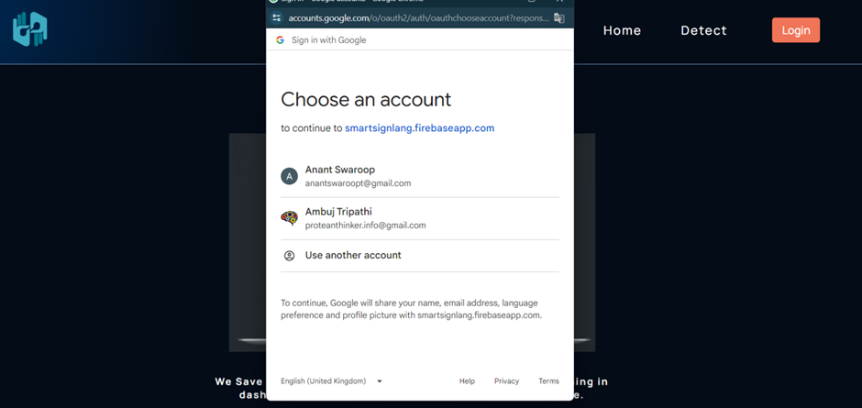
User Authentication:
Our sign language translation application, seamlessly built with React.js for an intuitive user interface and Firebase for robust login authentication, fosters effortless communication and interaction.

Slide 15
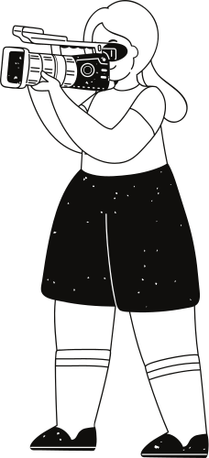
Future Scope:
Multilingual and Gesture Expansion
Speech-to-Sign Language Translator
Extend the model to encompass multiple sign languages prevalent globally, addressing the unique gestures and syntax of diverse signing communities.
Broaden the scope by integrating a bidirectional translation system that not only recognizes sign language but also translates spoken language into sign language. This feature enhances the communication potential
Collaborative Learning
Autocorrect and Predictive Text
Implement machine learning techniques that enable the system to learn and adapt from user interactions, fostering continuous improvement.
Enhance the autocorrect feature by integrating advanced natural language processing algorithms. This ensures accurate word prediction, reducing errors and enhancing the overall efficiency.

Slide 16
References:
[1] Abdulhussein, A.A. and Raheem, F.A. (2020). Hand gesture recognition of static letters American sign language (ASL) using deep learning. Engineering and Technology Journal, 38(6), pp.926-937.
[2] B., Abhishek & Krishi, Kanya & M., Meghana & Daaniyaal, Mohammed & S., Anupama. (2020). Hand gesture recognition using machine learning algorithms. Computer Science and Information Technologies. 1. 116-120.
[3] Chava Sri Varshini, et al. (2020). Sign Language Recognition. International Journal of Engineering Research Technology (IJERT), 09(05).
[4] Chavan, S., et al. (2021). Convolutional Neural Network Hand Gesture Recognition for American Sign Language. In: 2021 IEEE International Conference on Electro Information Technology (EIT), IEEE, p. 188-92.
[5] Chong, Teak-Wei, and Boon-Giin Lee. 2018. "American Sign Language Recognition Using Leap Motion Controller with Machine Learning Approach" Sensors 18, no. 10: 3554.
[6] Eid, Ahmed, and Friedhelm Schwenker. (2023). "Visual Static Hand Gesture Recognition Using Convolutional Neural Network" Algorithms 16, no. 8: 361.
[7] Gadge, Siddhesh, Kharde, Kedar, Jadhav, Rohit, Bhere, Siddhesh, & Dokare, Indu. (2023). "Recognition of Indian Sign Language Characters Using Convolutional Neural Network." *International Journal of Innovative Technology and Exploring Engineering (IJITEE)*, 12(3), 5464-5469.
[8] Haria, A.P., Subramanian, A., Asokkumar, N., Poddar, S., & Nayak, J.S. (2017). Hand Gesture Recognition for Human Computer Interaction. Procedia Computer Science, 115, 367-374.
[9] Hochreiter, S., & Schmidhuber, J. (1997). "Long Short-Term Memory." Neural Computation, 9(8), 1735–1780. doi: 10.1162/neco.1997.9.8.1735.
[10] Huang, H., et al. (2019). Hand Gesture Recognition with Skin Detection and Deep Learning Method. In: Journal of Physics: Conference Series, 1213, IOP Publishing, p. 022001.
[11] Islam, M. Z., et al. (2019). Static Hand Gesture Recognition Using Convolutional Neural Network with Data Augmentation. In: 2019 Joint 8th International Conference on Informatics, Electronics & Vision (ICIEV) and 2019 3rd International Conference on Imaging, Vision & Pattern Recognition (icIVPR), IEEE, p. 324-9.
[12] Juneja, S., et al. (2021). Computer Vision-Enabled Character Recognition of Hand Gestures for Patients with Hearing and Speaking Disability. Mobile Information Systems, 2021.
[13] Krizhevsky, A., Sutskever, I., & Hinton, G. E. (2017). ImageNet classification with deep convolutional neural networks. Communications of the ACM, 60(6), 84-90.
[14] Lugaresi, C., Tang, J., Nash, H., McClanahan, C., Uboweja, E., Hays, M., Zhang, F., Chang, C.L., Yong, M.G., Lee, J. and Chang, W.T. (2019). Mediapipe: A framework for building perception pipelines. arXiv preprint arXiv:1906.08172.
[15] Nivedita, S., Ramyapriya, Y., et al. (2022). "Sign Language Recognition System Using Machine Learning." *International Journal of Innovative Technology and Exploring Engineering (IJITEE)*, 11(1), 4186-4191.
[16] Perdana, I. P. I., Putra, et al. (2021). Classification of Sign Language Numbers Using the CNN Method. JITTER: Jurnal Ilmiah Teknologi dan Komputer, 2(3), 485-93.
[17] Pigou, L., et al. (2014). Sign Language Recognition Using Convolutional Neural Networks. European Conference on Computer Vision, 6-12 September 2014.
[18] Rajan, G. S., Nagarajan, et al. (2019). Interpretation and Translation of American Sign Language for Hearing Impaired Individuals Using Image Processing. International Journal of Recent Technology and Engineering (IJRTE), 8(4), 415–420.

Slide 17
Thank you very much!
Presented by MP23CST024

